Slide 1

Visualization tool Shell pants design 1 In works

Slide 2
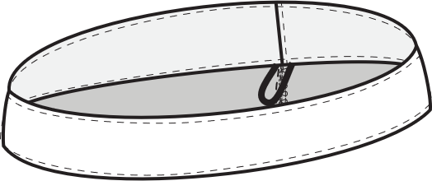
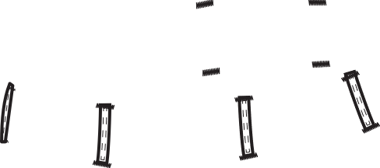
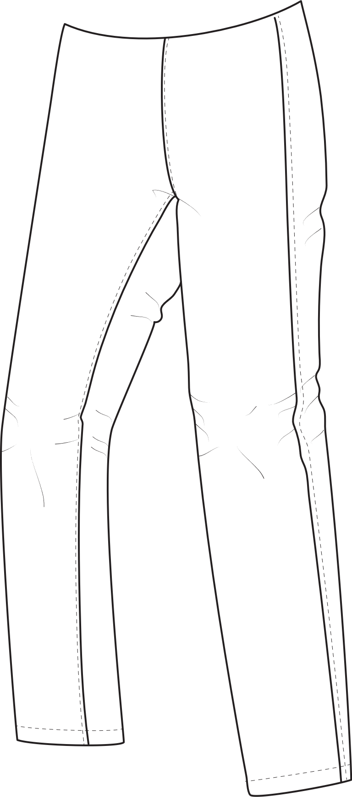


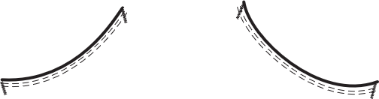
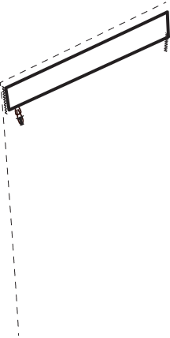
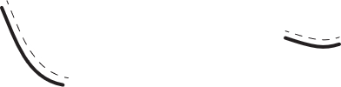
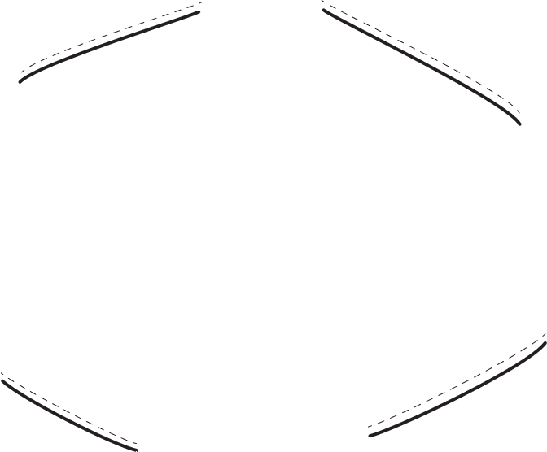
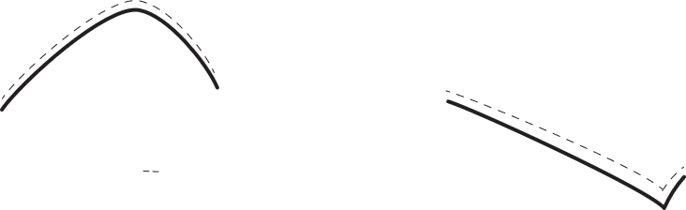
Product 1 + 2
(stretch + non-stretch)
In works
Shell pants 1_4_2_2_butt1knee1hem1_0_2_0_0
Comment: not sure if that file name is any better?
Pattern info:
There is no visual differernce between Design seams and reinforcements.
The difference is in the pattern pieces only.
Reinfocements are sewn on top of a fabric piece while the design seams are seams that connect two single layered fabric pieces.
Pattern pieces for example:
’Zipper front’ has always a button:
left side for men (example)
right side for women
’Waist band Standard 1’ has always:
’zipper front’ + button:
left side for men
right side for women
’Knee design seams’ and ’knee reinforcements’, the
’thigh zip pockets’ change to: ’zip reinforcem’
Design seams:
Waistband: 1 piece
Hand pockets: 2 pieces
Zipper fly: 2 pieces
Zip thigh pocket: 3 pieces
Front pants:
Front 1 +2: 1 piece each
Knee: 1 piece
Hem: 1 piece
Back pants bottom: 1 piece
Butt: 1 piece
Reinforcements:
Waistband: 1 piece
Hand pockets: 2 pieces
Zipper fly: 2 pieces
Zip thigh pocket: 3 pieces
Front: 1 piece
Back pants: 1 piece
Knee reinforcement: 1 piece
Hem reinforcement : 1 piece
Butt reinforcement: 1 piece
Note: reinforcement pattern pieces are slightly bigger
Pattern pieces
Women + Men
Main:
xx piece
Sewing instrcutions:
Start pages 1-4
Sewing pages 5-xx
File: Sewing instructions_products_Shell pants design 1

